Slide 1
Welcome to 2nd grade!
Daily Schedule:
7:20 - 7:50 Unpacking and Announcements
7:50 – 8:40 Writing Workshop
8:40 – 9:25 Specials
9:25 – 10:25 Science / Social Studies / Health
10:30 – 11:30 Math
11:30 – 12:40 Lunch / Recess
12:45 – 2:15 Reading Workshop
2:15 - 2:30 Dismissal

Slide 2
Reading Workshop
Common Core State Standards for Reading
is divided into these strands:
Reading Literature
Reading for Information
Foundational Skills
Speaking and Listening
All lessons are tied to CCSS and are designed to . . .
Set high and achievable goals on an individual basis
Add rigor and require higher order thinking skills
Accommodate student interests and learning styles

Slide 3
Reading Workshop
The workshop is segmented into three arenas to keep students engaged at all times and maximize teaching time.
Daily 5
Read to Self
Work on Writing
Read to Someone
Listen to Reading
Work on Words
Student Choice Centers
“Must Do” activities to be finished each week
Enrichment activities independent work
Technology enhanced activities for remediation and enrichment
Guided Reading
Small group instruction
Materials are presented on actual Fountas and Pinnell reading levels
Assessments taken on grade level

Slide 4
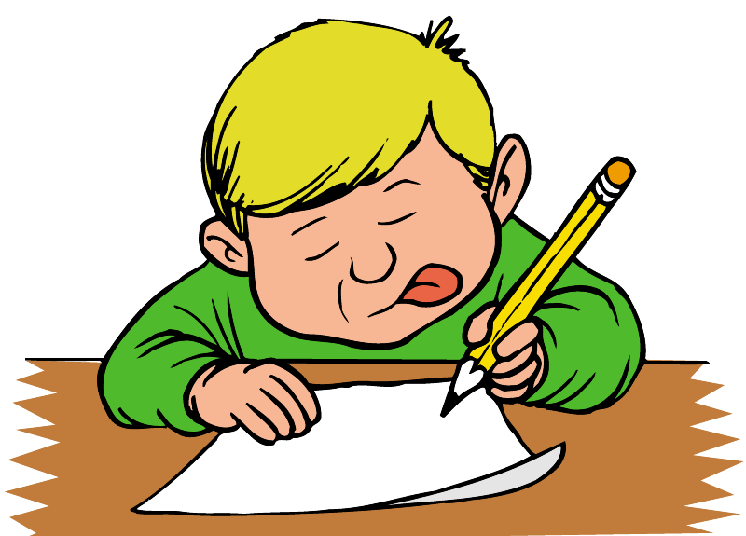
Writing Workshop
Common Core State Standards for Writing are divided into these strands:
Language usage and conventions
Word usage and meaning
Written Communication Skills
All lessons are tied to CCSS and are designed to . . .
Set high and achievable goals in an individual basis
Add rigor and require higher order thinking skills
Accommodate student interests and learning styles

Slide 5
Writing Workshop
Writing Genres
Narrative
Informational
Opinion
Lucy Caulkin’s Writer’s Workshop
Student’s work at their own pace through the writer’s workshop process.
Teacher conferences with students based on their needs.
Grammar will eventually become part of the writer’s workshop so that authentic usage errors can be addressed and corrected more effectively

Slide 6
Second Grade Math
Place value of a three-digit number
Skip counting by 5s, 10s, and 100s within 1,000
Compare two-digit number using >, =, <
Addition and subtraction regrouping
Money
Customary units of measurement: inch, foot, yard
Metric system: centimeter and meter
Tools for measuring length: ruler, yardstick, centimeter ruler, meter stick

Slide 7
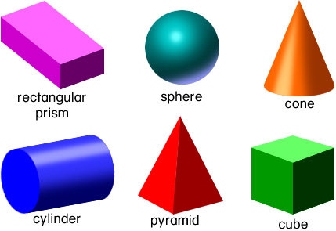
Second Grade Math
Telling time to the nearest five minutes
Relationship of hours and days
Addition of four 2-digit numbers
Line plots, number lines, bar graphs, and pictographs
Geometric shapes: plane and solid figures
Fractions: halves, thirds, fourths
Arrays, repeated addition, and multiplication
Odd and even numbers

Slide 8
Third Grade Math
Investigate, understand, and use place value to manipulate numbers.
Round whole numbers.
Properties of addition: Associative, Commutative, and Identity
Multiplication and division
Area and perimeter
Properties of Multiplication: Commutative & Distributive
Algebra: “n” or “x” representing the unknown quantity
Create and interpret pictographs and bar graphs

Slide 9
Third Grade Math
Identify quadrilaterals and polygons
Partition shapes into equal parts of halves, thirds, fourths, sixths and eighths
Expand the ability to see the real world
Comparing fractions
Numerators and denominators
Tell and write the time to the nearest minutes
Solve elapsed time
Units of mass and liquid volume
Word problems

Slide 10
Science
Physical Attributes of Stars
Position of the Sun and Moon and Their Patterns Throughout the Year
Causes of Change
Properties of Matter
Sources of Energy
Pushes and Pulls
Life Cycles
Panther Pete’s Science Lab

Slide 11
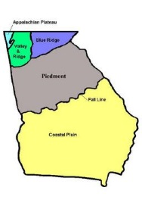
Social Studies
Before There was a Georgia
Topographical features of Georgia
Georgia’s Beginnings
The founding of Georgia by the British at Savannah and their interactions with the Creek natives.
Native Georgians
Cherokee culture and their interaction with European settlers
Civil Rights
Contributions of Jackie Robinson and Martin Luther King, Jr. as leaders in the Civil Rights movement
Human Rights
Contributions of Jimmy Carter as a human rights advocate.
Personal Finance
The self-discipline required to make informed and reasoned decisions concerning wise spending and saving choices.

Slide 12
Communication
This year we will be using weekly blogs for
volunteer opportunities and communication.
http://secondgradenpes.weebly.com
http://mrslowery2nd.weebly.com http://mrsmayj.weebly/com
http://judyparson.weebly.com
Agenda- please sign nightly
Please send notes for absences and transportation changes.
lowery@fultonschools.org mayj@fultonschools.org
parsonj@fultonschools.org

Slide 13
HOMEWORK
Homework will be given Monday –Thursday
Monday – Thursday Reading and Logging
Monday and Wednesday- Language Arts
Tuesday and Thursday- Math
Homework should not take more than 30 minutes.
This includes the daily reading log.
Reading logs are due and should be returned on Fridays.
Social Studies and Science homework may be given as study guides for tests.

Slide 14
Questions?
Thank you for attending
Curriculum Night!

